Slide 1
Traction
By: Sarah Gobbell

Slide 2

What is Traction?
Traction is the process of putting an extremity, bone, or group of muscles under tension by means of weights and pulleys (pulling force) to treat muscle and skeletal disorders.

Slide 3

Purpose
Traction is used to treat:
  Fractures
  Dislocations
  Long-duration muscle spasms
  Prevent or correct deformities

Slide 4
Divisions of Traction
Skin traction
Skeletal traction
Short-term (accident scene)
Long-term ( hospital setting)

Slide 5
Skin Traction
Used for temporary treatment if a light or continuous force is needed.
Five to seven pound weights are attached to the skin through adhesive or non-adhesive tape, with straps, boots, or cuffs.
Allow good circulation to the part of the limb beyond the point where traction is applied.

Slide 6
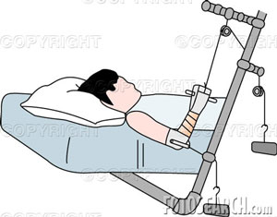
Skin Traction: Dunlop’s Traction
Dunlop’s skin traction is applied to children with certain upper arm fractures that need to remain in a flexed position to prevent problems with circulation and nerves around the elbow.

Slide 7
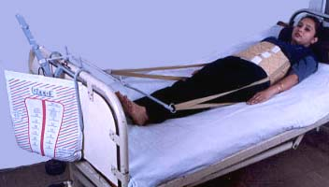
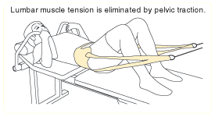
Skin Traction: Pelvic Traction
Pelvic Traction is applied to the lower spine with a belt around the waist

Slide 8
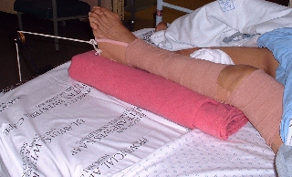
Skin Traction: Buck’s Skin Traction
Buck’s skin traction is used to treat knee injuries other than fractures. This kind of traction is used to stabilize the knee and reduce muscle spasms.

Slide 9
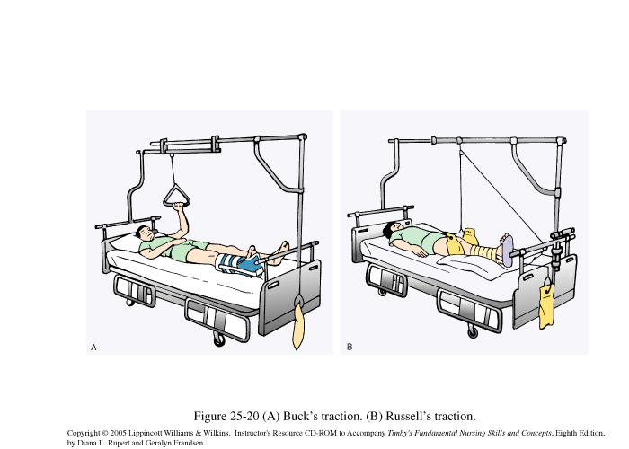
Skin Traction: Russell’s Traction
Russell’s traction is very similar to Buck’s, but instead they use a sling to allow more movement in bed and allows flexion of the knee joint.

Slide 10
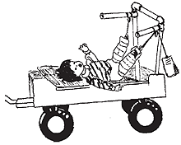
Skin Traction: Bryant’s Traction
Bryant’s traction is used for children with fractured femurs. Both legs are suspended at 90 degree angles to the trunk of the body and the weight of the body pulls the bone fragments of the fractured leg into alignment.

Slide 11
Skeletal Traction
Used when more pulling force is needed.
Uses weights of 25-40 lbs.
Requires placement of tongs, pins, or screws into the bone so that the weight is applied directly to the bone.
This is an invasive procedure done in an operating room.
Done under local, general, regional anesthesia.

Slide 12
Skeletal Traction Cont'd
The pins may be in place for several months and must be kept clean to prevent infection.
Pulleys and weights are attached to wires to provide the proper pull and alignment of the affected part.

Slide 13
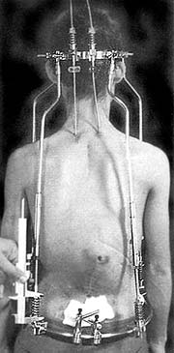
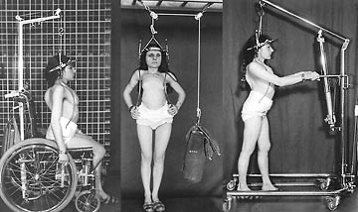
Skeletal Traction: Halo
Halo traction is used for cervical fractures and can also be used to help correct deformities such as kyphosis as seen on the upper right.

Slide 14
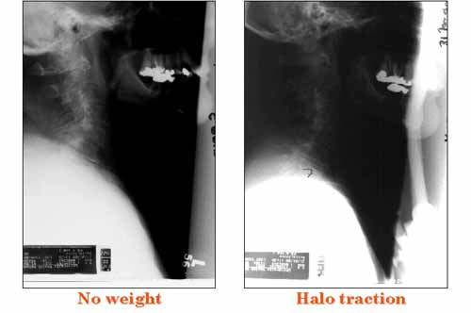
Skeletal Traction: Halo Cont’d
This pictures shows the effects of the halo traction, before (left) and after (right)

Slide 15
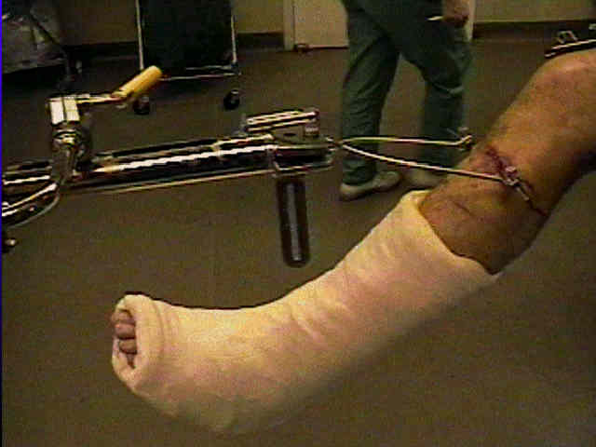
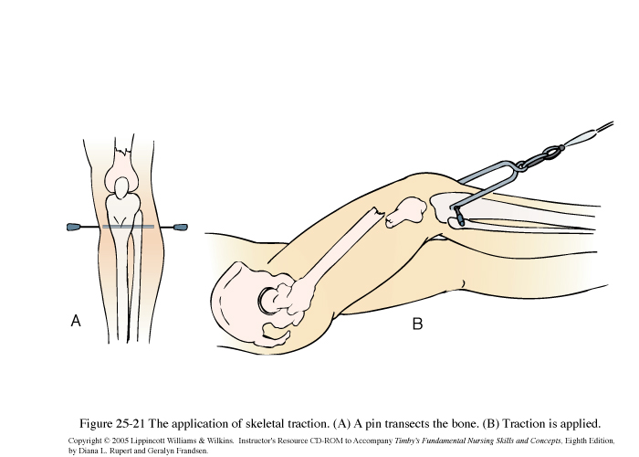
Skeletal Traction: Tibia Pin
Used for some fractures of the femur, hip, or pelvis
Pins are surgically inserted into the femur and weights are then applied in order to correct the problem

Slide 16
Pre-Op
X-rays are done pre-op and may be repeated during treatment to assure a stable alignment
Blood and urine tests are done
Pt may meet with an anesthesiologist to discuss health conditions (if skeletal traction is being done)

Slide 17
Post-Op
Skin Traction
Make sure the limb stays aligned.
Make sure skin does not become sore or irritated.
Be sure pt is alert to any swelling or tingling due to the limb being wrapped too tightly.

Slide 18
Post-Op
Skeletal Traction
Traction may be continued for several months until healing is complete.
Deep breathing exercises are taught.
Range-of-motion done to unaffected parts of the body.
Pt teaching is done on how to use a trapeze bar.

Slide 19
Risks
Two main risks are: traction is applied incorrectly or the skin becomes irritated.
Bone inflammation may occur.
Infection may occur at the pin sites.
Because of long periods of immobility, the pt may develop bed sores, reduced respiratory function, urinary or circulatory problems.
Traction can take an emotional toll on the pt.

Slide 20
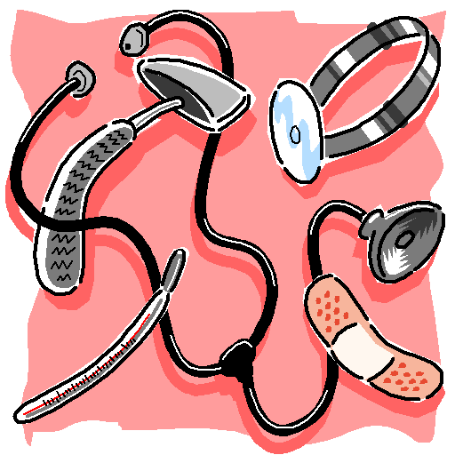
THE END

